Slide 1
Meeting 6 Helping Children with Birth Family Connections

Slide 2
Identity and Culture
Identity
Self-concept
Connections
Culture

Slide 3
Indian Child Welfare Act (ICWA)
The Indian Child Welfare Act:
Provides funds to tribes to operate child and family services programs;
Gives tribes exclusive jurisdiction over any American Indian child who resides within the reservation;
Gives tribal courts exclusive jurisdiction over any child who is a ward of the tribal court

Slide 4
Multiethnic Placement Act of 1994 (MEPA) and Amendment of 1996 (IEP)
Decreases the time children wait to be adopted;
Prohibits denial or placement delays (by any agency receiving federal funds) because of race, color, or national origin;
Encourages transracial placements when appropriate same-race placements are not available;

Slide 5
Multiethnic Placement Act of 1994 (MEPA) and Amendment of 1996 (IEP) (continued)
Prevents discrimination in child placement or in the choice of foster and adoptive homes, based on race, color, or national origin;
Develops a diverse pool of foster and adoptive families

Slide 6
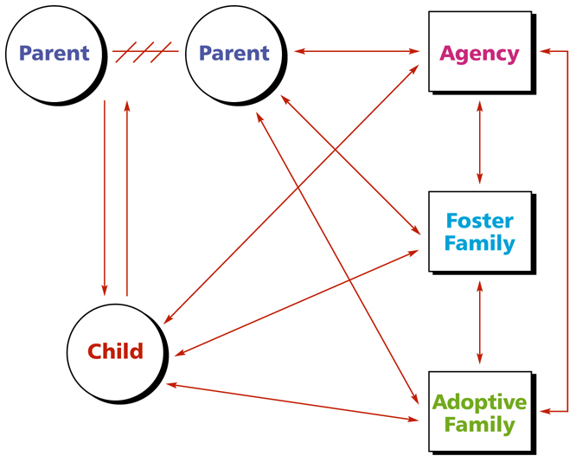
The Alliance Model of Child Welfare Practice*
*Adapted from Thomas D. Morton, “Partnerships in Parenting,” CWI.

Slide 7
Shared Parenting
Occurs when two or more adults have joint responsibility for care, nurturing, and decision making for the same child.

Slide 8
What are the benefits when parents and foster parents share parenting?

Slide 9
What are the benefits to the foster parents when caring, nurturing, and decision making is shared with parents?

Slide 10
The Role of Foster Parents in Building Alliances with Parents of Children in Foster Care
Recognize and support parent strengths
Use strengths to engage parents
Maintain confidentiality
Manage personal emotions
Share power and control
Model parenting skills, mentor and/or teach parents

Slide 11
Directions for Shared Parenting Activity
Your team has 5 minutes to create as many ideas as possible for sharing parenting between visits.

Slide 12
Roadwork
Complete the “Foster and Adoptive Parents’ Guide for Successful Visits or Contacts
Write a letter to the parent of a child who may be placed in your home using Handout 10
Read Handouts 4, 5, 6, and 7

